Slide 1
CONDITIONAL PROCESSING – PART 2
Sangram Kesari Ray <SHANKAR.RAY030@GMAIL.COM>

Slide 2
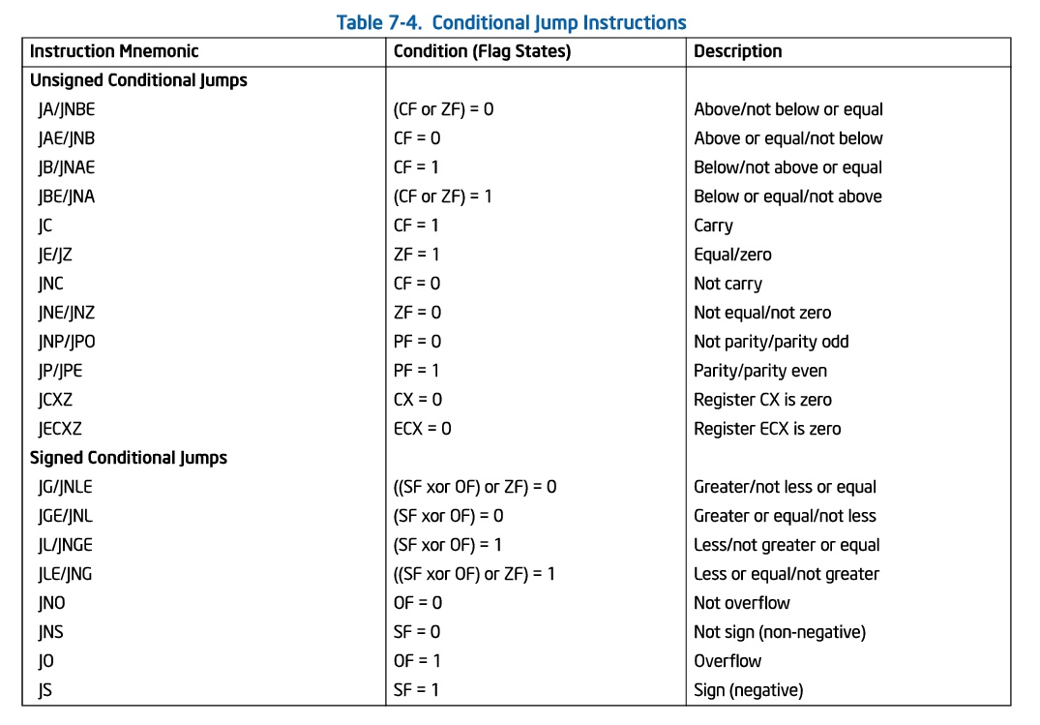

Slide 3
DEMO
https://github.com/shankar-ray/Assembly-Language-Tutorials-for-Windows

